Slide 1

Jobs GROUP
jobs DIAGNOSTICS guidance
Why, what and how?

Slide 2
OUTLINE
Why Conduct Multi-sector Jobs Diagnostics?
  Jobs are central to achieving poverty reduction and shared prosperity
  Recognize need to take more comprehensive and multi-sectoral approach
Use of a Jobs Diagnostic
  Covers the whole spectrum of `employment’ – eg agriculture, own account, self-employment, wage; formal & informal enterprises and workers; but excludes care of family & housework
  Standalone ESW to inform policy and operations
  Complement the SCD where expanding job opportunities is a key priority
Objective: determine key challenges to “expanding job opportunities”:
  More jobs – for un & underemployed; to absorb new labor market entrants; creating more jobs that enable transformations (structural, spatial, formalization)
  Better jobs – higher productivity jobs, higher returns, better working conditions
  Inclusive jobs – for poor and bottom 40%, women, youth, disadvantaged groups, those previously not participating in labor force
    Elements of a Jobs Diagnostic:
  Establish country context and key jobs needs (to guide diagnostic steps 2 & 3)
  Interpreting the interplay of results: Identify challenges, constraints, synergies, causes
  Defining priorities and identifying possible solutions (lay out opportunities, trade-offs)

Slide 3
Why conduct JOBS diagnostics?
Jobs are the number one priority consistently expressed by the citizenry and by the policy makers of our client countries, independent of region or income levels
Jobs are at the center of development, World Development Report 2013 Jobs
  Labor is the most important asset of the poor
  Jobs are the most important pathway out of poverty
  Development happens through jobs
  How / whether job opportunities expand is a key determinant of how widely the benefits of growth are shared
Expanding jobs is central to meeting the twin goals.
Challenges are inherently multi-sectoral and complex

Slide 4
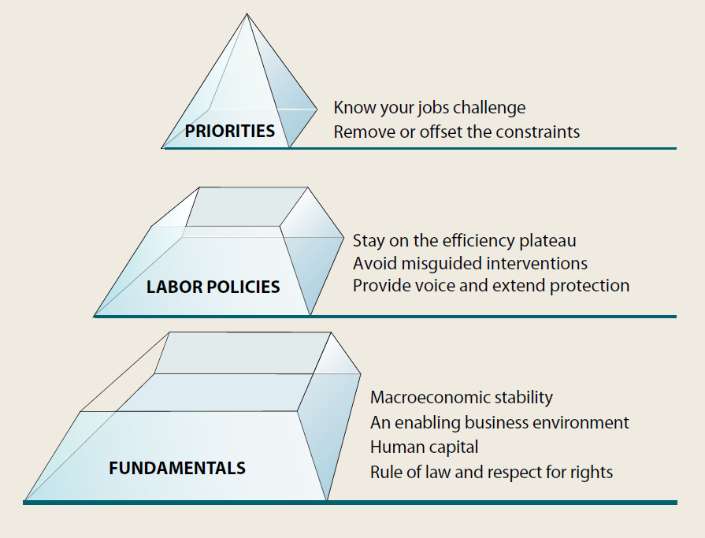
why a multi-sector jobs diagnostic?
“Jobs” is about more than a specific factor of production, labor.
Jobs challenges are inherently multi-sectoral and complex:
  Requires access to markets, inputs, capital, technology, skills, matching supply and demand
  Shaped by regulatory framework (not only labor regulations), macroeconomic conditions, rule of law, governance
  Potential for spillovers, “good jobs for development”, highlight different opportunities based on country context
Most approaches to date have been sector-specific – But they have not had the needed impact.
  Wide consensus that we need to take a more comprehensive approach.

Slide 5
Why a New Jobs Diagnostic?
  Most of our tools and diagnostics to date are sector specific and/or focused on growth or investment, not on jobs
  Investment Climate Assessments consider constraints to formal firms’ investments and productivity growth
  Growth Diagnostics (Hausmann, Rodrik, Velasco) are built around the entrepreneur’s decision to invest
  Skills Assessments consider the supply of skills across people
      STEP surveys look at demand for skills too, but have limited links to firm performance
  ADePT Labor provides tables that profile workers from households (supply side)
  Diagnostic Trade Integration Surveys mostly consider barriers to trade integration in products (and more recently services) and more recently exporters (firms)
    Existing tools each tell an important piece; we need to bring them together
Benefits of a more comprehensive and multi-sector approach:
  Identify synergies and interactions across dimensions
  Build a framework to link analytic results to core challenges
  Enables a more systematic approach to find possible solutions to jobs challenges

Slide 6
Use of a jobs diagnostic
  Examine links between jobs, growth and the twin goals.
  Examine opportunities for expanding job outcomes – looking at composition of jobs, determinants of mobility across employment categories and ways to raise productivity within categories
  Not just about expanding wage work or formal sector -- raising productivity of self-employment, agriculture and informal enterprises are important in many client countries
Jobs Diagnostic can be:
  Standalone ESW or complement the Systematic Country Diagnostic (SCD)
      Particularly for countries where expanding jobs opportunities is identified as a priority, having a full jobs diagnostic would expand on the analysis included in the SCD
      Note: Separate guidance for more streamlined approach to incorporating jobs into SCDs is also available on the SCD and Jobs websites
Identify priorities, binding constraints and possible solutions
  Intended to inform policy priorities and provide practical ways forward
  Offers tailored solutions to clients’ jobs problems, fitted to their contexts and jobs needs
Bring together GPs to work collectively across sectors to identify synergies and trade-offs in addressing a client country’s key jobs challenges
Share learning of multi-sectoral approaches to common jobs challenges

Slide 7
Use of a jobs diagnostic: what it doesn’t do…
The jobs diagnostic does not cover the following related topics:
  A full growth diagnostic: there are elements common to both diagnostics, such as returns to education as a supply side test, and enterprise dynamics for labor demand, but where growth is insufficient to create enough jobs, a growth diagnostic is justified.
  Cyclicality in aggregate demand, jobs and growth; the diagnostic deals with longer term structural issues around demand for workers
  All links with poverty and growth – income sources beyond employment such as cash transfers.
  Social protection policies and benefits for those not in work such as social insurance and pensions transfers will not be covered, except under incentives to work
  Indicators of labor market institutions and core labor standards are provided, but will not necessarily be assessed in-depth unless raised as key constraints
  There is no assessment of implementation capacity or political economy of reform beyond team’s assessment in Step 3; more detailed work would need to be done separately or draw on the SCD/CPF.
  Solutions: the point of the jobs diagnostic is to help identify and prioritize key constraints to creating more, better and inclusive jobs to reduce poverty and promote shared prosperity.
The CCSA is capturing and curating global knowledge on jobs solutions for specific problems / constraints in the form of a catalogue of `jobs solutions’. This will be informed by past work of GPs, academic research and evaluations, as well as by the jobs diagnostics.
The diagnostic is based on quantitative assessments of outcomes – it does not make normative judgments of policies, and although growth paths and opportunities are taken into account in identifying priorities, the diagnostic does not simulate nor model future jobs outcomes.
Notes:
Not be

Slide 8
Objectives: determine key challenges to “expanding job opportunities”
1. More people join the labor force & find work (including self-employment) as firms start up, enter markets, and expand
  Firm dynamics (self-employment start-ups, firm entry and firm growth) leads to job creation
  Increased labor participation and increased employment rates
2. Labor moves across from less to more productive jobs:
  Structural change reallocates across sectors
  Selection reallocates across businesses (and creates net more jobs)
  Migration reallocates across geography
  Formalization reallocates across businesses
3. People get better at doing their existing job:
  Returns to labor assets improve (incl thru’ farming, self-employment)
  Labor productivity rises within occupations;
Workers benefit from higher productivity through higher earnings and
  demand more goods and services.
Externalities from good jobs support development
Remove barriers to accessing good jobs; opportunities are
  Open to the poor and bottom 40%, women, youth, disadvantaged
MORE
JOBS
BETTER
JOBS
INCLUSIVE JOBS
3 goals are not mutually exclusive – e.g. want ‘more’ jobs created to be ‘better’ ones – and can involve trade-offs – e.g. raising productivity may reduce the number of net jobs

Slide 9
Elements of a jobs diagnostic
  Step 1: Basic Analysis: Establish country’s jobs needs (guides the focus of diagnostic steps 2&3):
      Set context: Identify the country type, the country conditions and challenges (including demographic trends, sector composition, fragile state etc), and establish comparators
      Identify relative importance of creating more, better and inclusive jobs
        Present the changing profile of jobs, workers and employers
  Step 2: Interpret Results: Use structured inquiry to define the key jobs challenges and identify the underlying causes / constraints on all three dimensions:
      More jobs: Is the economy creating sufficient jobs relative to the working age population?
        Growth – is growth sufficient? Is elasticity of employment to growth too low? Are jobs being created in areas that encourage transformations (structural; spatial; formalization)?
        Demand constraints to job creation – fundamentals, business environment, governance
        Supply constraints – insufficient labor force participation, skills
      Better jobs: Is productivity rising? Is the proportion of working poor declining in the labor force?
        Are new and existing jobs more productive?
        Are people raising productivity of current jobs or reallocating time to more productive jobs?
        Are earnings rising? Are worker vulnerabilities addressed?
      Inclusive jobs: Who has access to jobs?
        Are job dynamics contributing to poverty reduction and promoting shared prosperity?
        Are women, youth, minorities able to access job opportunities?
  Step 3: Define priorities and find possible solutions
      Look for synergies in solutions that can address multiple dimensions of jobs challenges more efficiently and effectively; recognize where trade-offs need to be made, and why

Slide 10
the Jobs Diagnostic’s Links to The twin goals
Step 1: Helps identify the jobs profile and jobs needs for the bottom 40%.
Identifies where workers from poor households and the bottom 40% work; who is creating their jobs, and how income from labor contributes to their welfare.
Trends in poverty, and patterns of work and remuneration for poor people over time
Characteristics of the working poor (age, sector, gender, human capital, urban/rural)
Step 2: Examines links between jobs outcomes, growth and twin goals
More jobs: Are the poor and bottom 40% able to expand their labor force participation and/or reduce under-employment? Do these jobs expand with growth?
Better jobs: Are the jobs of the poor and the bottom 40% increasing in productivity and earnings over time? What is the contribution of `better jobs’ to poverty reduction?
Inclusive jobs: Are the poor and bottom 40% able to access more and better jobs?
Are the poor and bottom 40% included in the job opportunities associated with key economic transformations (structural change, urbanization, formalization)?
Step 3: When prioritizing opportunities and constraints to expanding job opportunities, use their impact on the poor and their contribution to promoting shared prosperity as key considerations.

Slide 11

Step 1A – Establish Country context
Jobs Diagnostic
Growth & employment trends (aggregate; by sector)
Demographics (aging; youth bulge)
Shapely decomposition
Trade dynamics (X & M)
Trends in real wages
Trends in migration and remittances
Identify
Country
Trends
Type,
Conditions &
Comparators
Typologies (Not mutually exclusive):
Agrarian
Resource rich
Island State
Migration economy
In-Recession/crisis
Conflict & Fragility*
Youth bulge
Ageing
Urbanizing
Formalizing
*Additional guidance will be prepared for Countries with FCV features
Step 1A:
Macro policy indicators (interest rates, real exchange rates)
Financial sector (depth, inclusion)
Labor market policies and core standards
Educational attainment
Infrastructure availability, cost
Investment climate indicators
Jobs Group is producing a standard “Jobs At A Glance” that will include these indicators of ‘fundamentals’ and `labor policies’
Key policy indicators

Slide 12
Step 1B – profile of jobs, workers and employers
Jobs Diagnostic
Working age not in labor force
Unemployed
Employed
Profile
of Jobs
and Workers
(Bottom 40%, overall)
Agriculture
Unpaid work
Non-farm self-employment
Wage work
Employers
Disaggregate each by:
Gender
Age
Income decile
Rural / urban
Education
Informal
Formal
Step 1B:
Informal
Formal
Profile of Employers
and Job
Creating
Enterprises (household enterprises, informal and formal enterprises)
Size
Age
Ownership
Sector /products
Formal/informal
Location
Performance
Where data allows, look at dynamics over time in how these profiles are changing

Slide 13

STEP 1B. EXAMPLE: JOBS PROFILE IN KENYA
Typical data sources:
Population Censuses
Labor Force Surveys
Representative household surveys
Tools:
ADePT Labor
Working Age Population
20.6m
Employed
14.3m
Other
6.3m
Family Farming
6.5m
Non-farm self-employment
2.7m
Wage work
5.1m
Inactive
1.6m
Students
2.7m
Home-makers
1.9m
Informal
3.1m
Modern
2.0m
Private
1.3m
Public
0.7m
With 10% of those employed working in formal private sector wage jobs, any jobs strategy in Kenya will have to focus on raising opportunities in agriculture and the informal sector too.

Slide 14
STEP 1. Example: profile of employers and job creating firms over a decade in uganda by location and firm size
This example shows that nearly all new job creation in Uganda in the decade 01-11 came from urban micro & firms, whilst large firms were shedding jobs in both urban and rural areas
Uganda’s jobs “needs” may include urban informal sector productivity measures, and a focus on why large firms have been shrinking
Jobs CCSA with DEC & GSURR for Uganda Economic Update (forthcoming)

Slide 15
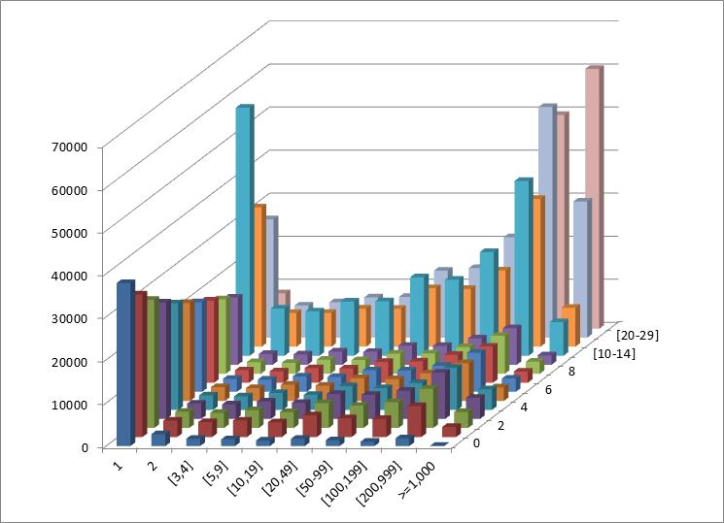
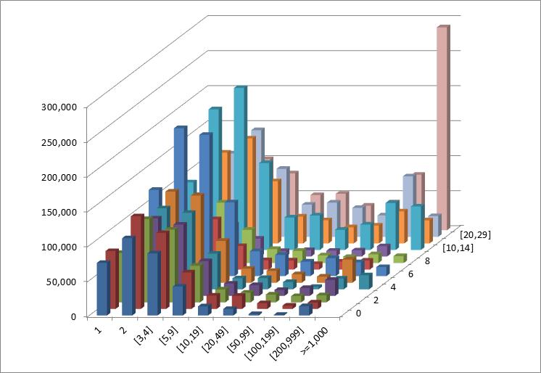
STEP 1. Example: ENTERPRISE DYNAMICS: EMPLOYMENT DISTRIBUTION BY AGE AND SIZE OF FIRMS in mena
These examples show that in common with Tunisia, Egypt has a “missing middle”, lacking in small and medium enterprises which could exert competitive pressure on larger and older incumbents
This was a symptom of a privilege-driven system, whereby older larger firms got political protection.
Tunisia (1997-2010): employment by size and age
Egypt: Employment in 2006 by firm size and age
Jobs or Privileges: unleashing the employment potential of the Middle East and North Africa

Slide 16
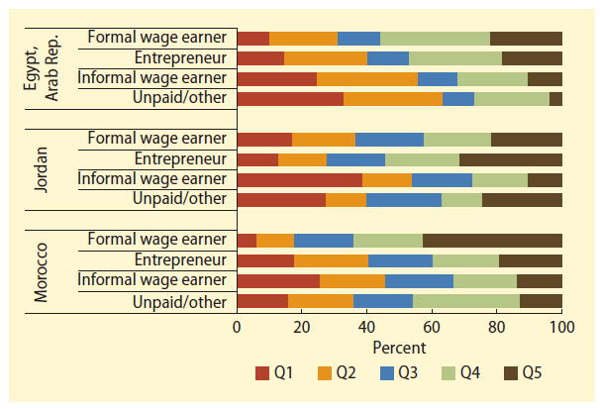

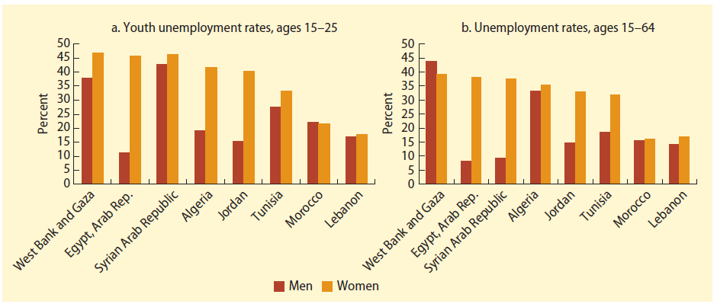
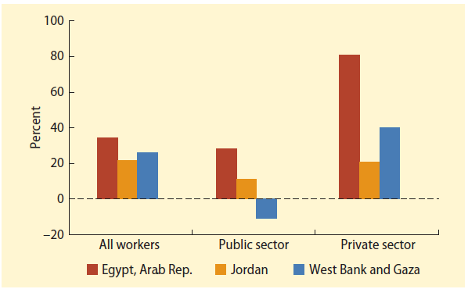
STEP 1. Example: identifying `better’ and `inclusive’ jobs in mena
This profile shows:
Wage work is the preserve of wealthier quintiles, the bottom 60% of income earners work in the informal sector;
that women are much less likely to participate in the labor market in Egypt, Syria, Jordan and Tunisia than elsewhere.
That wage gaps for women are very significant, especially private sector wages
The jobs need may be to remove barriers to women’s LF participation
Income quintile of different types of workers
Unemployment rates by gender and age
Male-female wage gaps by sector

Slide 17
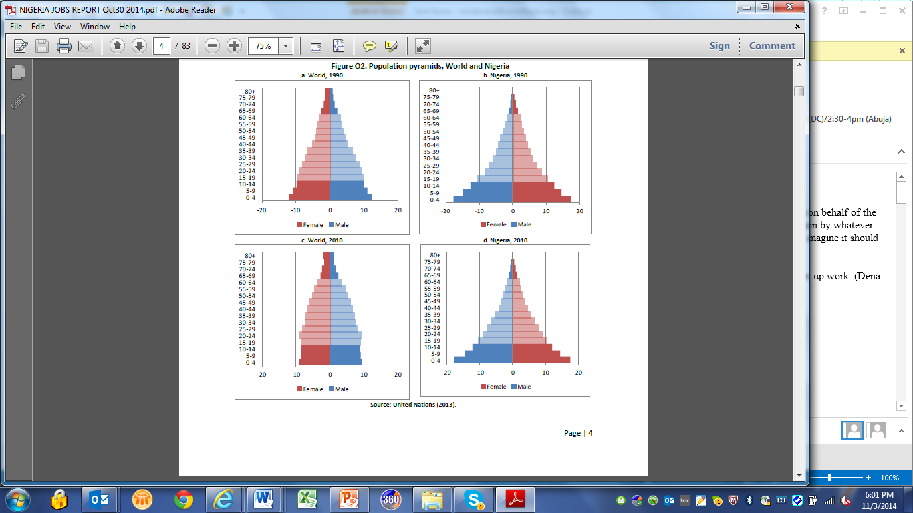
Step 1: Example: jobs needs from demographic trends in nigeria
Population Pyramids: World and Nigeria
Unlike the world population which is aging (left side), Nigeria’s population has stayed young between 1990 and 2010 (right side)
This and a high fertility rate mean Nigeria will face a youth bulge in the labor market for many years to come.
This makes youth employment and the transition from school to work an important jobs need for Nigeria for some time to come

Slide 18
Step 2: Diagnosis: DEFINE [structural] jobs CHALLENGES AND look for THEIR [binding] Constraints
Guided inquiry (all 3 parts should be examined):
Step 2a: Is aggregate (and sector) growth sufficient to create more jobs? Does growth translate into job creation?
    Step 2b: Are new jobs better jobs? Are returns to work improving?
    Step 2c: Are expanding job opportunities inclusive?
    The diagnostic provides:
    A series of questions to investigate and identify key challenges (with forthcoming guidance and training on data availability and tools to conduct the analysis)
    A series of potential underlying causes and constraints associated with the different jobs challenges: at the heart of these is the dynamic between productivity and employment.
    Teams should be selective: identifying the most important issue given step 1 findings
    The Jobs CCSA is developing with GPs, a common clustering of jobs challenges or ‘syndromes’ that will help guide teams to effective approaches to address jobs challenges
    (This diagnostic is not designed to cover macro cycles, nor short-term policy impacts on cyclical growth and unemployment, although lasting employment effects eg of privatization/liberalization on labor markets may justify safety nets and employment schemes, and should be discussed).

Slide 19
Step 2A – constraints/opportunities for More jobs
Jobs Diagnostic
It is possible that causality runs from jobs to growth: ie jobless growth reduces demand which reduces production, savings, etc
Why Not?
What’s the constraint? (Examples)
Sector composition of growth is too capital intensive
Commodity boom (natural path)
Dutch disease
Tax policies favoring capital
Low availability of skills
Limited non-cognitive skills
High labor (hiring/firing) restrictions
Is growth creating enough jobs (whether formal or informal)?
Step 2a:
Is growth
sufficient to create Jobs?
(real GDP growth >= LF growth)
Skills
Low participation
High reservation wage
Constraints to women’s participation
Low worker incentives from labor taxes and poor design of social benefits
Limited mobility
High public sector wage
Yes
Labor supply constraints
No
Poor investment climate
Limited access to finance, FDI
Low innovation, limited external trade
Low churning; limited firm entry
Technology favors capital over labor
Tax/regulations favor K over L
Negative ST impact of policy reform
No
Yes
Labor demand constraints
Consider Growth
Diagnostic
Step 2b:
Are better
Jobs being
Created?
Labor market
matching
problems
Limited information
Discrimination
Segmentation
Limited mobility – including where trade and FDI are disruptive short-term

Slide 20
Step 2B– constraints/opportunities for Better jobs
Jobs Diagnostic
Why Not?
What’s the constraint? (Examples)
Productivity does not improve within existing jobs; new jobs are low productivity
Limited structural transformation
Lack of competition; lack of innovation
Limited trade (entry, product diversification)
Limited creative destruction and reallocation
Inadequate markets; limited scale economies
Lack of investment, FDI
Low skills
Weak rule of law
Constraints to women’s entrepreneurship
No
Step 2b:
Are Better Jobs being created?
Labor is not moving across jobs, lack of matching
Restrictive labor market policies
Geographic segmentation; limited migration, urbanization
Land tenure / access
Housing
Societal norms, eg on gender participation, ethnicity
Higher reservation wage , high search costs, entry costs
Yes
Real
earnings not rising with productivity
Excess supply of skills
Substitutability capital for labor
Limited worker rights
Excessive labor flexibility
Informalization; many informal competitors
Step 2c:
Are Jobs
Inclusive?
Worker vulnerabilities are not addressed
Working poor are a significant and not declining share of the labor force
Lack of minimum labor standards
Minimal social protection, incl. anti-discrimination
Low or variable earnings (self-employment or wage)

Slide 21
Step 2C – Constraints/opportunities To Inclusive jobs
Jobs Diagnostic
Why Not?
What’s the constraint? (Examples)
Not Accessible to Poor or Bottom 40%
Lack of employability
  Skills (cognitive, non-cognitive)
Lack of mobility, transportation
High fixed costs of entry
Relative costs of household responsibilities
Discrimination
Step 2C:
Are Jobs
Inclusive?
High costs of transport / child care (in MICs)
Early family formation
Discrimination
Lack of experience (school to work transition)
Lower education
Societal norms
High reservation wage
Insider / outsider connections
Unionization / apprenticeships
Not accessible to women
youth
disadvantaged groups
No
Yes
Lesson
Learning
Limited infrastructure
Lack of information / connectivity
Local skills
Limited access to input and output markets
Lagging Regions

Slide 22
Step 3: Prioritize BETWEEN CONSTRAINTS to find solutions (reforms and investments)
When identifying reform and investment priorities practitioners should reflect on other studies (eg SCD, poverty, growth, ICA, FSAP, sector diagnostics), and reflect on:
Data: the availability of data to support an evidence-based approach to solutions
The appropriate balance of jobs needs (more, better, inclusive jobs) based on the existing profile of jobs, workers and employers, the priorities associated with the country typology and country conditions, and the demographic trends
The political economy of reforms and private investments, the Government’s own jobs and growth strategies, and the politics which may be driving these, driving reforms, and the jobs constraints
The challenges and associated constraints identified from the Jobs Diagnostic for action
  Whether appropriate to focus on SME, demand-side, supply-side, matching
  Whether structural transformation and reallocation is needed to improve productivity
  Whether barriers restrict access to better job opportunities for parts of the population
Specificity: Whether it is right to focus solutions on a specific narrow topic or issue: eg a segment of the labor market, a segment of the population, a sector, or a policy trade-off or transformative investment
Complementarities, synergies and trade-offs between problems and solutions: eg support reforms aimed at improving competition with transformative public and private investments (IFC).
Future prognoses: growth paths, opportunities and the investment and skills requirements of these.
Look for synergies across solutions that address multiple jobs challenges
Prioritization of constraints (and opportunities) for shared prosperity through jobs (which create labor incomes)
Source: Adapted from World Bank SCD Resource document, 2014.

Slide 23
Step 3 – define priorities & IDENTIFY solution areas:
Jobs Diagnostic
Jobs CCSA is developing a `jobs catalogue’ to capture and curate jobs challenges and jobs solutions
Choice of solutions should reflect underlying country context and specific constraints underlying challenge
Jobs Challenges
Possible Solution Areas: Examples
Improve labor productivity (overlap with “better” jobs) to stimulate hiring
Facilitate diversification
Examine relative tax treatment of capital and labor
Expand access to markets
Expand competition
Facilitate formalization
Facilitate urbanization
Reduce entry costs
Improve employability and matching
Facilitate migration / immigration
Improve school to work transition
Improve employability of excluded groups
Defend equal opportunities
Regulate against discrimination
Step 3:
From Country Context,
Performance
and Future
Projections
Identify
Country
Jobs Challenges
Jobless growth
(need more)
Jobs created are low productivity (need better)
Women or youth or ethnic groups are not getting jobs (need inclusive)

Slide 24
Step 3: ex #1 of cross-cutting solution areas
(taking account of country typology)
EXAMPLE1: Possible jobs solutions for a low income, mineral rich mostly rural economy, with youth bulge, and high degree of informality: where needs are to raise productivity in the informal sector and expand formal job creation.
Increase labor productivity for the self-employed:
      In agriculture, improve access to higher quality inputs and financial services
      In informal non-farm enterprises:
        Emphasis on training for youth entrepreneurship
        Regulatory approaches to enable productivity growth, expand access to assets and market places, especially in secondary cities and towns
  Encourage diversification:
      Encourage SME start-ups, higher value products, lower barriers to entry
      Offset `Dutch disease effects’ through productivity gains in non-traded sectors (including transport, energy, ICT)
      Deepen the labor market through skills and better matching; balance labor market flexibility with sufficient protections
  Facilitate urbanization:
      In secondary towns for rural services, facilitate migration to boom towns
      Ensure connectivity of urban informal firms with the rest of the city
      Promote labor market flexibility and matching
Better
Inclusive
More
Better
Inclusive
More
Better

Slide 25
Step 3: ex #2 of cross-cutting solution areas
(taking account of country typology)
EXAMPLE 2: Possible short-term jobs solutions for a low income, agricultural post-conflict country: where the priority need is to avoid slipping back into conflict.
Resettlement & productivity in rural areas:
      Ensure land rights, title and tenure system restores ownership equitably
      Support irrigation eg through community managed water schemes
      Ensure inputs and planting for the new season are adequately resourced
      Remove any administrative and procedural barriers to restoring crop markets and decent market prices for crops (eg licenses, trade/export bans, regulatory constraints to trade)
  Create job opportunities for ex-combatants and youth:
      Promote labor intensive public works for young people in reconstruction
      Use small infrastructure projects to give youth a stake in reconstruction
      Accelerate relevant skills training for ex-combatants, including in self- employment in trading and transportation activities.
  Reconstruction and connectivity between towns and rural areas:
      Rebuild regional markets to expand opportunities for self-employment and MSMEs (labor demand)
      Re-build regional telecom and power capacity
      Re-open trade and transport corridors internally and to export markets
      Establish open market price information through SMS services
  Use Jobs to strengthen social cohesion & provide a short-term peace dividend. Ensure coherence between short-term and sustainability
Inclusive
More
Inclusive
More
Better
Inclusive

Slide 26
Jobs TOOLS AND DATA AVAILABILITY (EXAMPLES)
Data Sources
Data Tools
Macro / aggregate :
WDI indicators
Jobs Data portal
ILO Key Indicators of the Labor Market (KILM)
UN demographic projections
National accounts surveys
Migration Facts Book
WITS
Households:
I2D2
Labor Force Surveys
Household survey (HHS/LSMS)
STEP Household Surveys
Firms:
Enterprise surveys and firm census
Enterprise Surveys (incl BEEPs)
STEP Employer Surveys
Policy indicators and coverage
Doing Business
Databases of Employment Protection Legislations
ASPIRE
Macro:
Shapely decomposition tool
Tools for Growth Analysis
Jobs Generation and Growth Decomposition (JoGGs)
Households:
Adept & Adept Labor
Firms:
Investment Climate Assessments
BuDDy
Trade:
Exports-Labor Elasticity Tool
Labor Mobility and Adjustment Costs toolkit
Eg the recent ECA jobs report used policy reform indices (building on existing data from Doing Business, EPL, etc) to derive a typology that categorizes countries on reform efforts.
MFM’s Find a Friend tool selects comparators based on various characteristics
Benchmarking

Slide 27
For more information…
http://www.worldbank.org/en/topic/jobsanddevelopment
Diagnostics Contacts @ Jobs CCSA: Mary Hallward-Driemeier, Dino Merotto, Pierella Paci, Michael Weber, Thoko Moyo
Jobs Knowledge Base:
http://globalpractices.worldbank.org/jobs/Pages/en/KBLanding.aspx
Contact Daniel Levine

